Slide 1
FIFA World Cup Analysis
Submitted by:
Rudrani Ghosh
UNID: UM/IP/1276
College: M.Sc. Data Science at VIT, Vellore

Slide 2
Problem Statement
With FIFA is in the blood of many people of the world. You are tasked to tell the story of unsung analysts who put great efforts to provide accurate data to answer every question of fans. The FIFA World Cup is a global football competition contested by the various football-playing nations of the world. It is contested every four years and is the most prestigious and important trophy in the sport of football.
The World Cups dataset shows all information about all the World Cups in history, while the World Cup Matches dataset shows all the results from the matches contested as part of the cups. Find key metrics and factors that influence the World Cup win. Do your own research and come up with your findings.

Slide 3
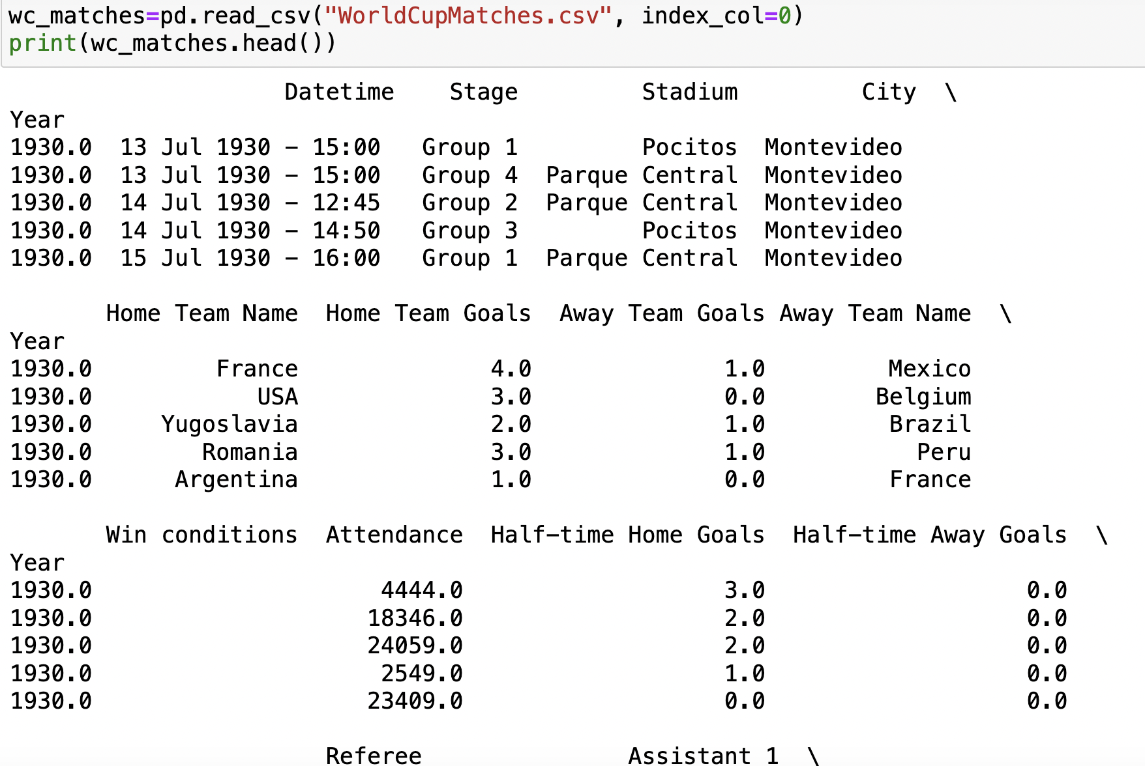
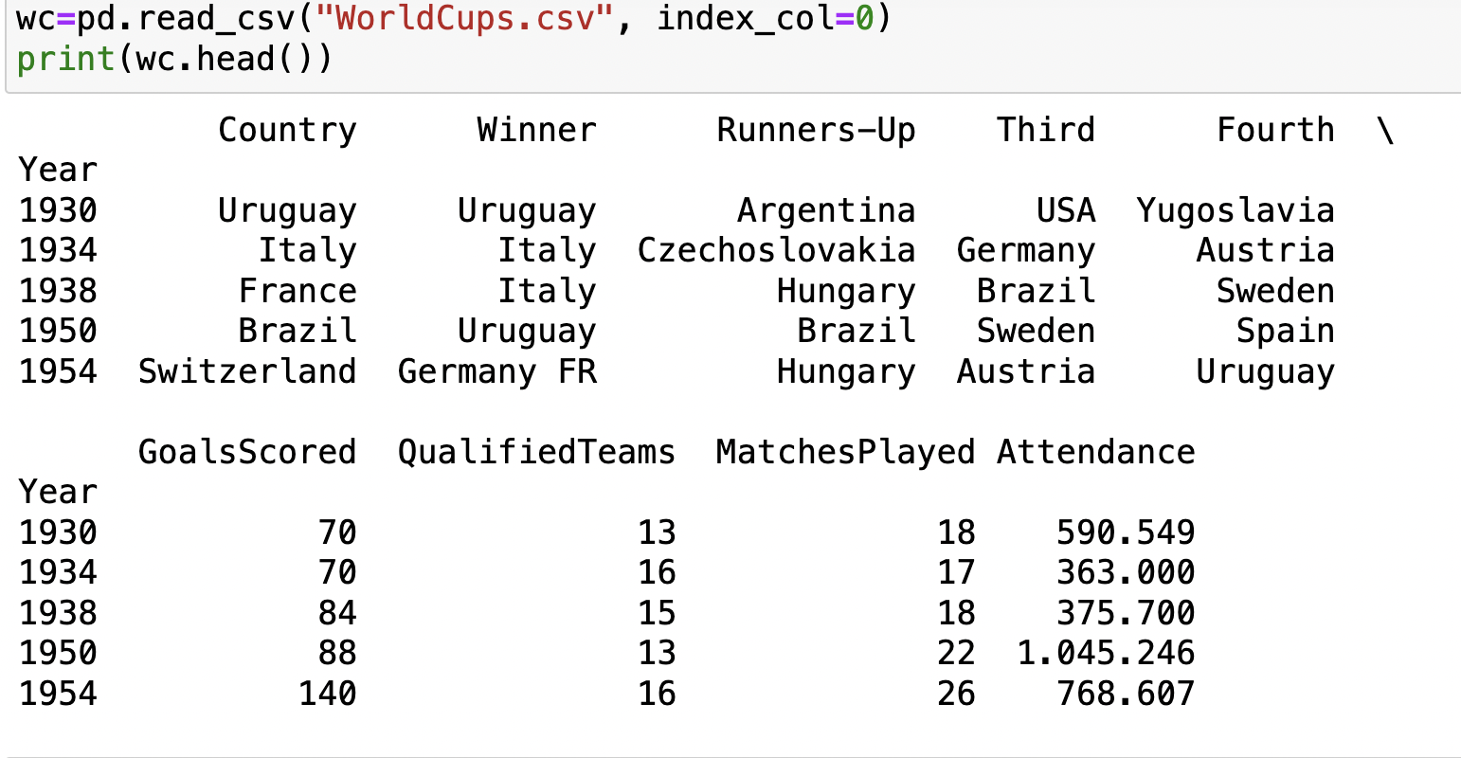
Details of Data

Slide 4
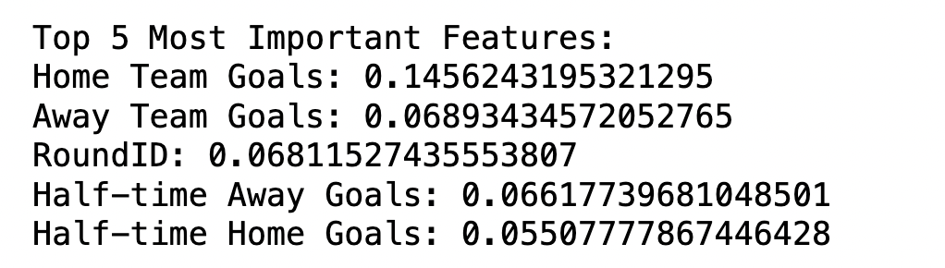
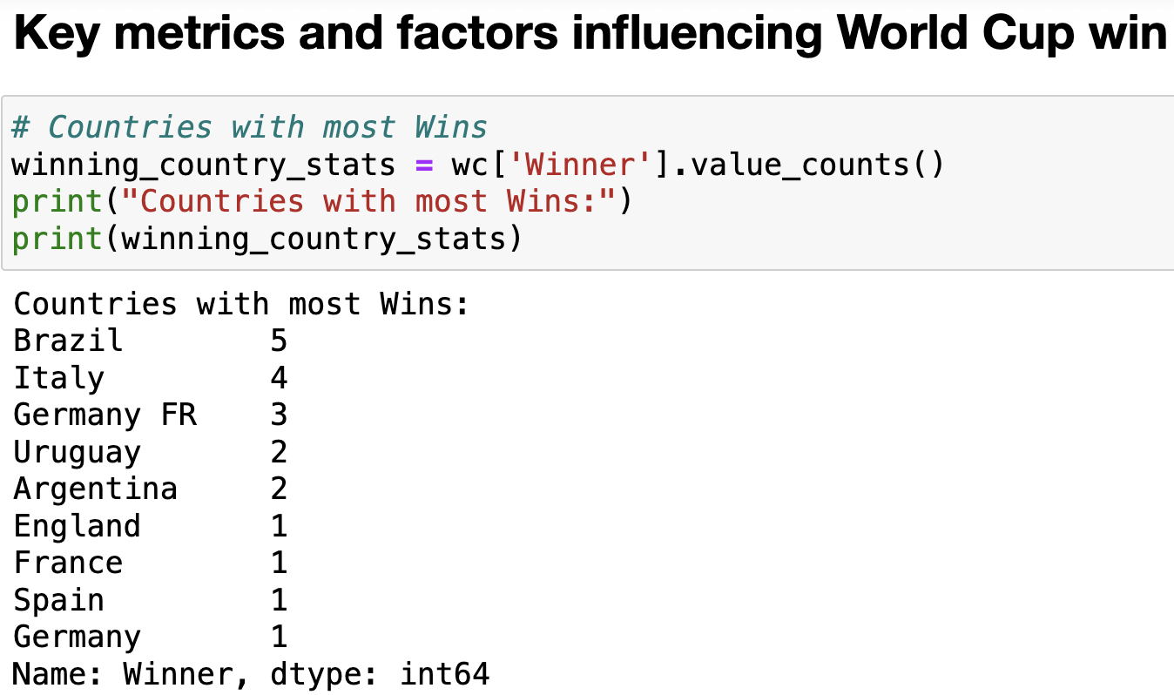
Main KPIs

Slide 5
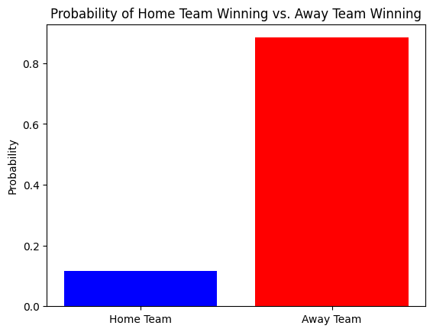
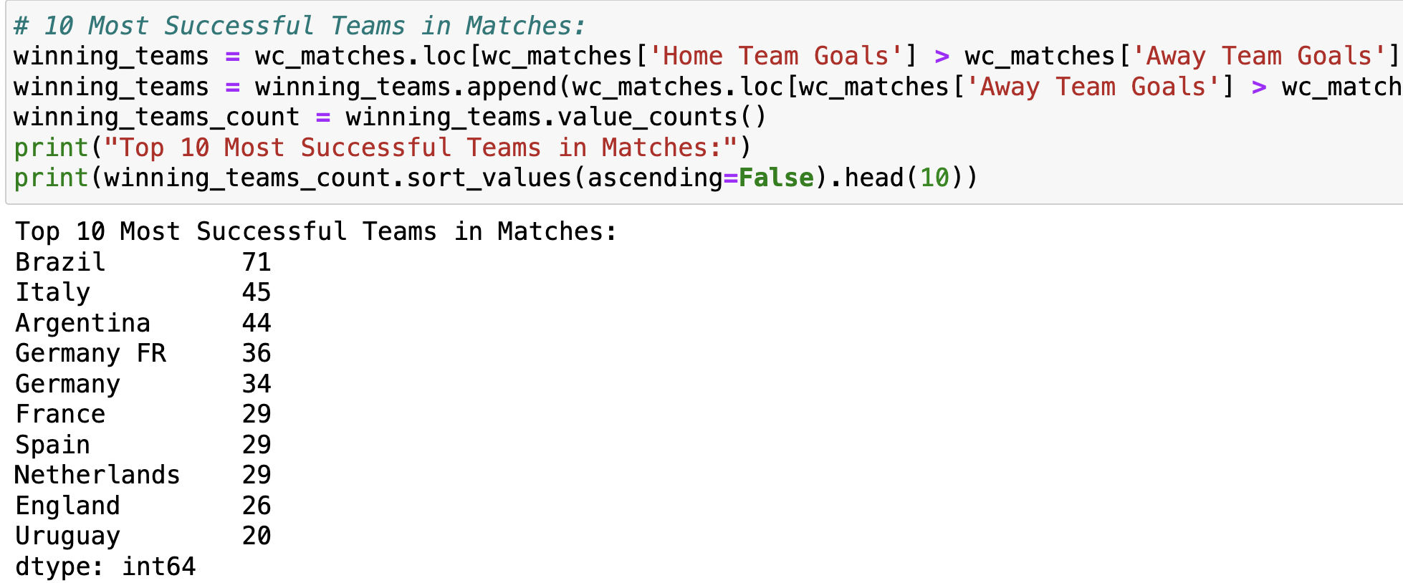

Slide 6
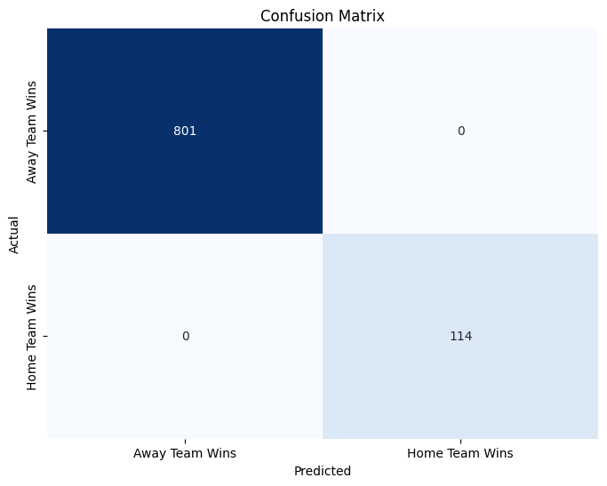
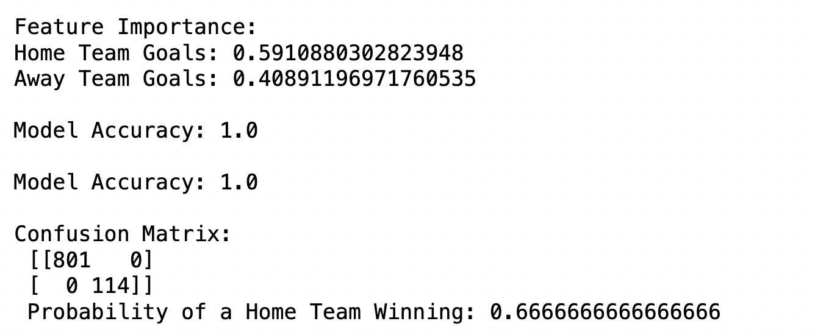

Slide 7
Thank you

